Slide 1
BLG252E-Object oriented programming
Practice Session 2

Slide 2
What will we cover?
Inheritance
Polymorphism

Slide 3
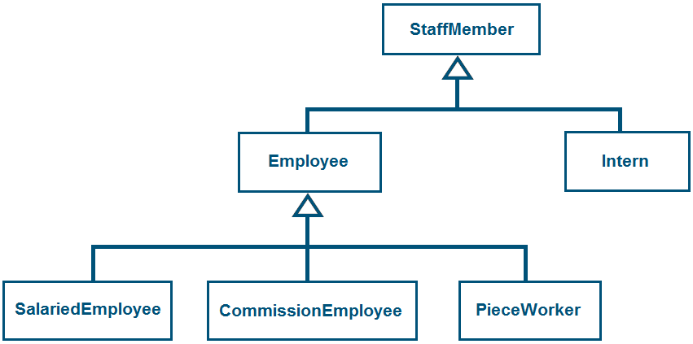
What will we do?
Consider a company whose staff member can be in following forms:
Employee
Salaried employee
Commission employee
Piece worker
Intern

Slide 4
Base Class: StaffMember
Data Attributes:
companyID
name
surname
Constructor to initialize all data attributes except companyID via keyboard. CompanyID will be given as an input parameter while creating objects(a unique id for each object, in ascending order).
Methods:
get and set methods for companyID, name and surname
print method to print all data attributes (virtual method)

Slide 5
First-level Derived Class: Intern
Additional data attributes:
schoolName
Constructor to initialize base class data attributes (except companyID) and schoolName with information taken via keyboard
Additional Methods:
get and set methods for schoolName
Polymorphic Methods:
print method to print base class data attributes and schoolName

Slide 6
First-level Derived Class: Employee
Additional data attributes:
socialSecurityNumber
Constructor to initialize base class data attributes (except companyID) and socialSecurityNumber with information taken via keyboard
Additional Methods:
get and set methods for socialSecurityNumber
pay method to calculate and return the amount of payment (virtual method)
Polymorphic Methods:
print method to print base class data attributes and socialSecurityNumber

Slide 7
Second-level Derived Class: SalariedEmployee
Additional data attributes:
weeklySalary
Constructor to initialize base class data attributes (except companyID) and weeklySalary with information taken via keyboard
Additional Methods:
get and set methods for weeklySalary
Polymorphic Methods:
print method to print base class data attributes and weeklySalary
pay method to calculate and return amount of payment

Slide 8
Second-level Derived Class: CommissionEmployee
Additional data attributes:
commissionRate
weeklySales
Constructor to initialize base class data attributes (except companyID), commissionRate and weeklySales with information taken via keyboard
Additional Methods:
get and set methods for commissionRate and weeklySales
Polymorphic Methods:
print method to print base class data attributes, commissionRate and weeklySales
pay method to calculate and return amount of payment

Slide 9
Second-level Derived Class: PieceWorker
Additional data attributes:
wagePerPiece
piecesProduced
Constructor to initialize base class data attributes (except companyID), wagePerPiece and piecesProduced with information taken via keyboard
Additional Methods:
get and set methods for wagePerPiece and piecesProduced
Polymorphic Methods:
print method to print base class data attributes, wagePerPiece and piecesProduced
pay method to calculate and return amount of payment

Slide 10
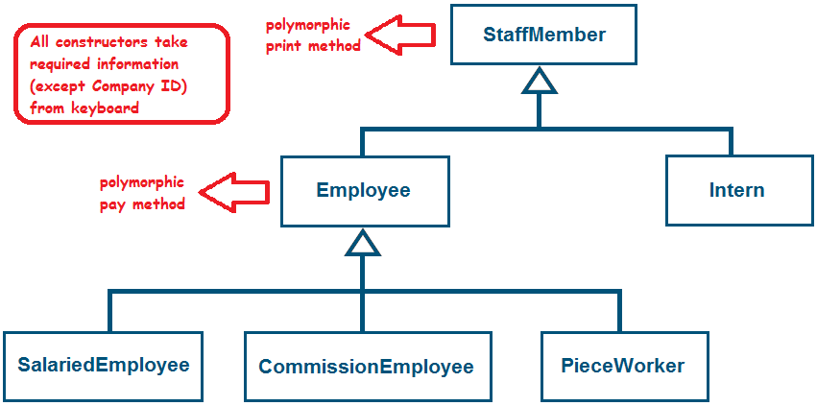
To Sum Up

Slide 11
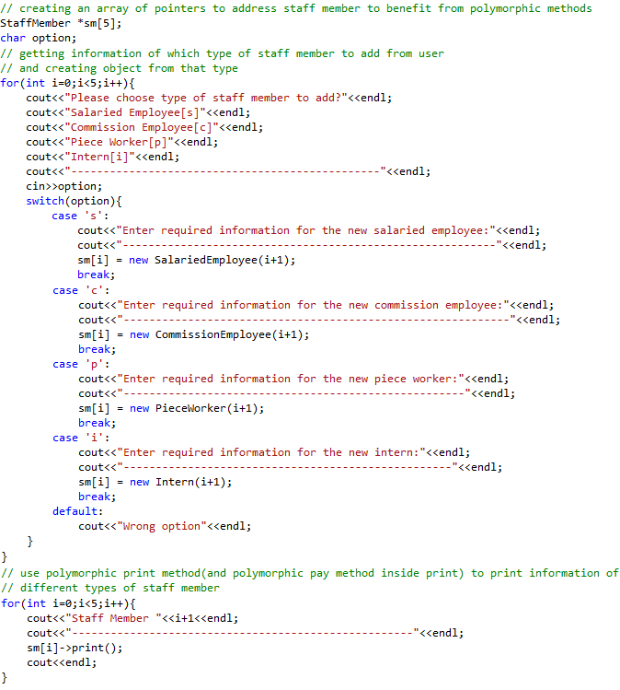
Test Program

Slide 12
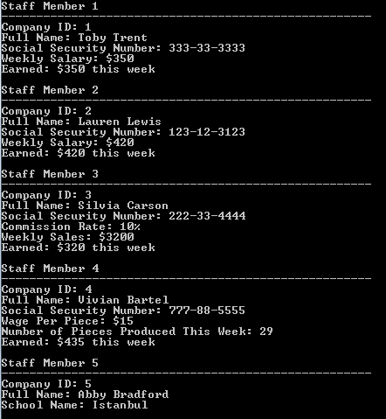
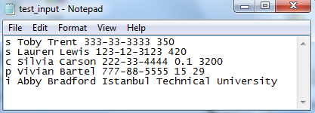
Example Input and Output
A text file can be used instead of standart input(keyboard) during execution as:
ps2.exe < test_input.txt
Contents of the example text file:
Output:

